Slide 1

E-Commerce Logistics Performance Analytics
Data-Driven Optimization of Delivery Operations
Sayan Bhattacharya - 2401020059
Palaparthi Harshakarthikeya - 2401010313
Arun - 2401010098
Keshav - 2401010221
Sarvesh Kumar - 2401010422
Mausam Kumar Dwivedi - 2401010266
Prepared by: Group 4 – Section A
Faculty Mentor: ____________

Slide 2

Context & Problem
• E-commerce depends heavily on fast logistics.
• Delayed deliveries reduce customer satisfaction.
• Objective: Analyze courier performance and identify improvement areas using KPIs and dashboards.

Slide 3
Data Engineering
Dataset: E-commerce delivery data
Total Orders: 8,449
Cleaning Performed:
• Removed null values
• Standardized courier names
• Converted delivery time into numeric format
Key Columns:
Courier | City | Delivery Type | Delivery Time | Rating

Slide 4
KPIs & Metrics
- Total Orders
- Average Delivery Time
- Product Rating
- Courier Order Share
- City-wise Delivery Speed

Slide 5
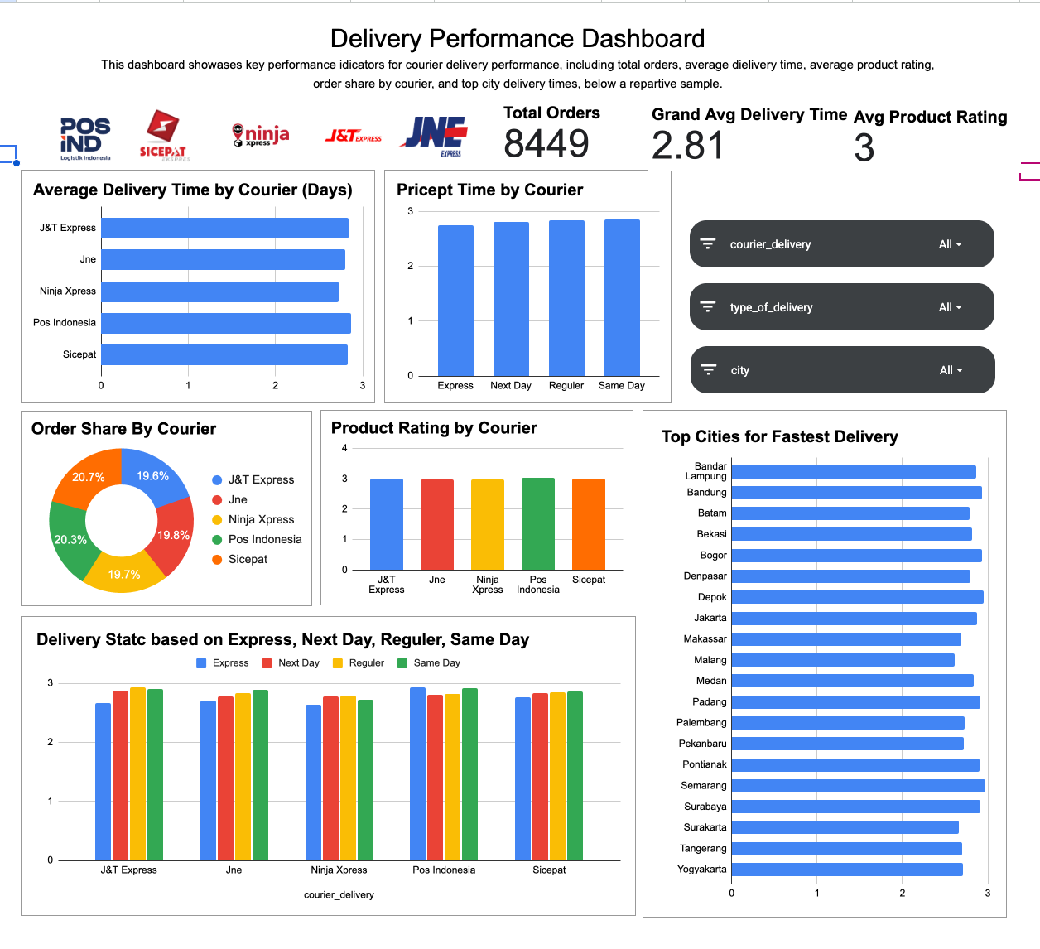
Key Insights
1. Average delivery time is ~2.8 days.
2. J&T Express and Ninja Express handle most orders.
3. Same-day delivery performs fastest.
4. Product ratings average around 3.
5. Cities like Bandung and Jakarta show quicker delivery.

Slide 6

Advanced Analysis
• Compared couriers across delivery types.
• Identified fastest cities.
• Analyzed rating vs delivery speed.
• Found operational gaps between delivery modes.

Slide 7
Dashboard Walkthrough
Executive View
• Total Orders: 8,449
• Average Delivery Time: 2.81 days
• Average Rating: 3
Operational View
• Courier performance
• Delivery types
• City comparison

Slide 8
Recommendations
• Promote Same-Day delivery in top cities.
• Improve low-performing couriers.
• Optimize routes in slower regions.
• Use customer feedback to improve ratings.
-

Slide 9

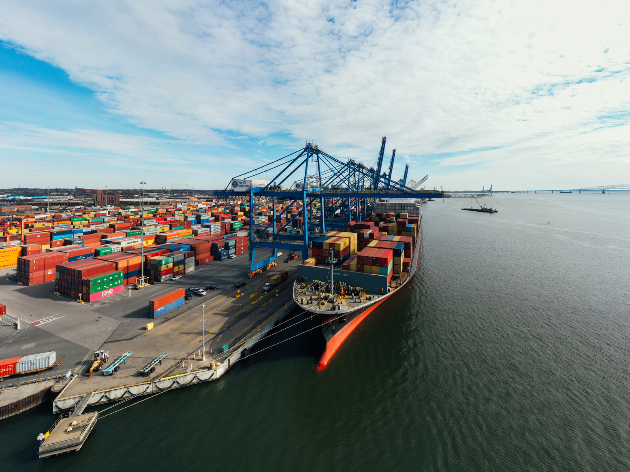
Impact & Value
- Faster deliveries → happier customers
- Better courier allocation
- City-level logistics planning
- Reduced delivery delays

Slide 10
Limitations & Next Steps
Limitations:
• No real-time tracking
• Limited customer data
Next Steps:
• Integrate courier APIs
• Add cost metrics
• Build ML delay prediction

